Slide 1

Safer, further, together with ‘air usa’
Why air travel is still a safer mode of transportation than others
By phil han

Slide 2
Air USA travel is way safer than automobile travel
1 in 3.37 billion chances of dying in a commercial airline plane crash between 2012-2016
1 in 20 million chances of being on a commercial airline flight experiencing a fatal accident from 2012-2016
Source: flyfright.com/statistics

Slide 3
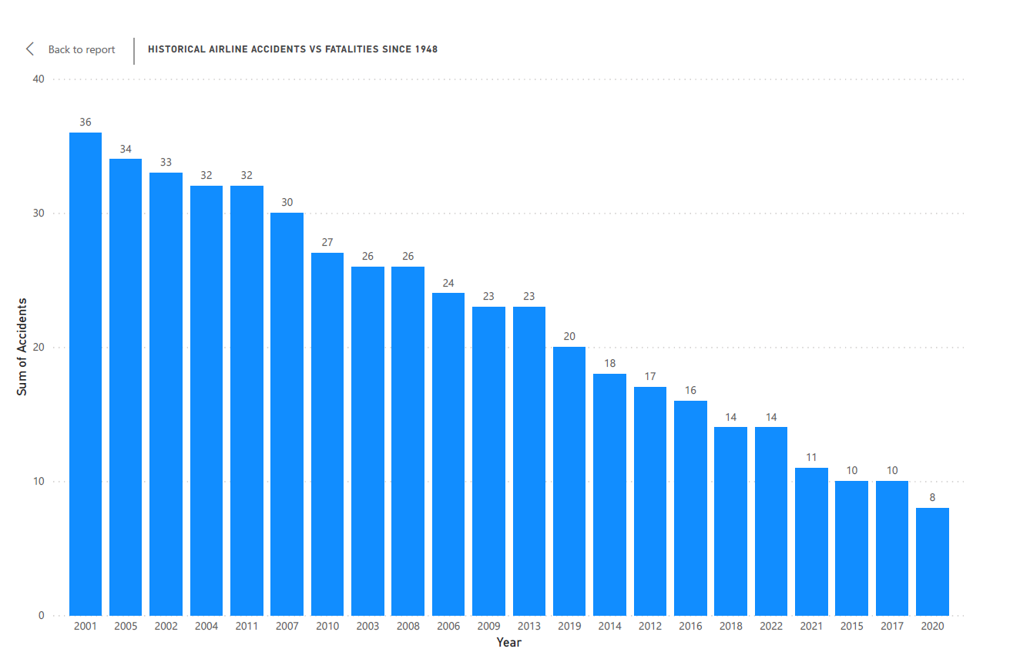
Safer than ever before
Over last 35 years, many years, air travelers have encountered fewer than 40 accidents per year.
With commercial air regulations, accidents have been on a downward trend-- even less than 20 accidents for the most of last 10 years

Slide 4
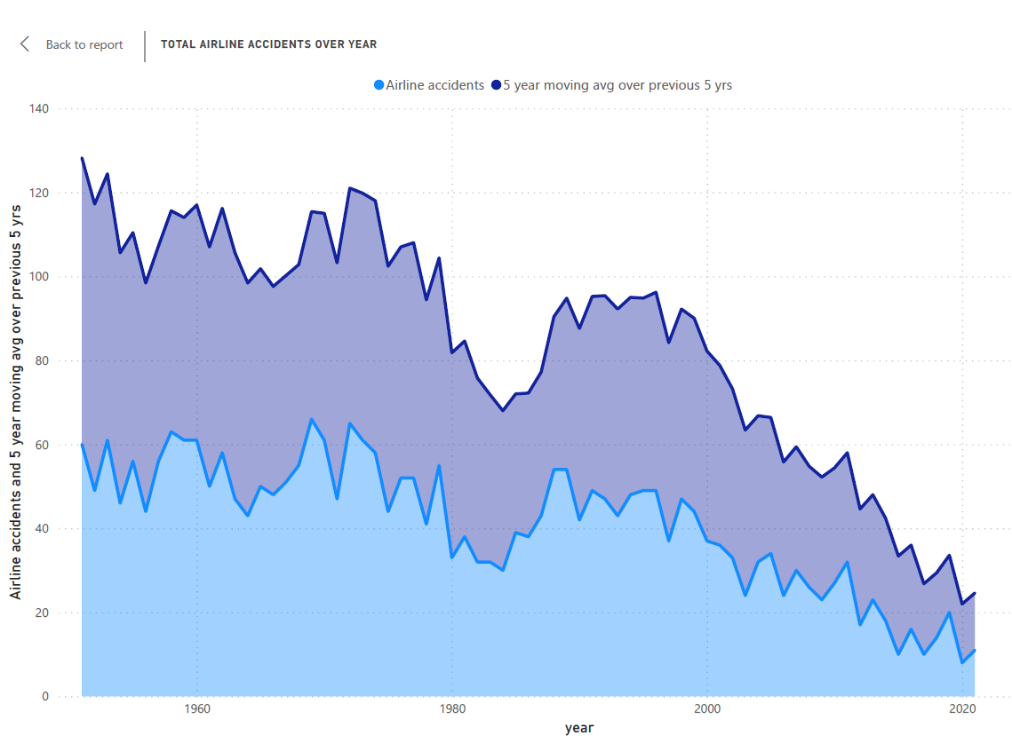

“If you took one domestic flight a day, every day of the week, odds are you could go 36,000 years before you’d die in a plane crash.”
-Dr. Arnold Barnett, MIT
Source: Air Travel –MIT Spectrum
Only 11 accidents in 2021

Slide 5
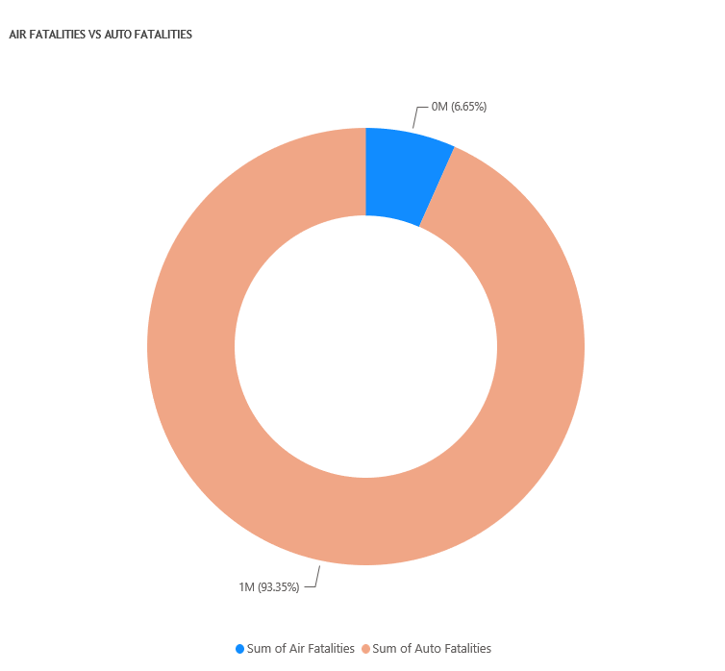
Automobile fatalities account for 93.35% vs. 6.65% for flights over the last 50 years.

Slide 6
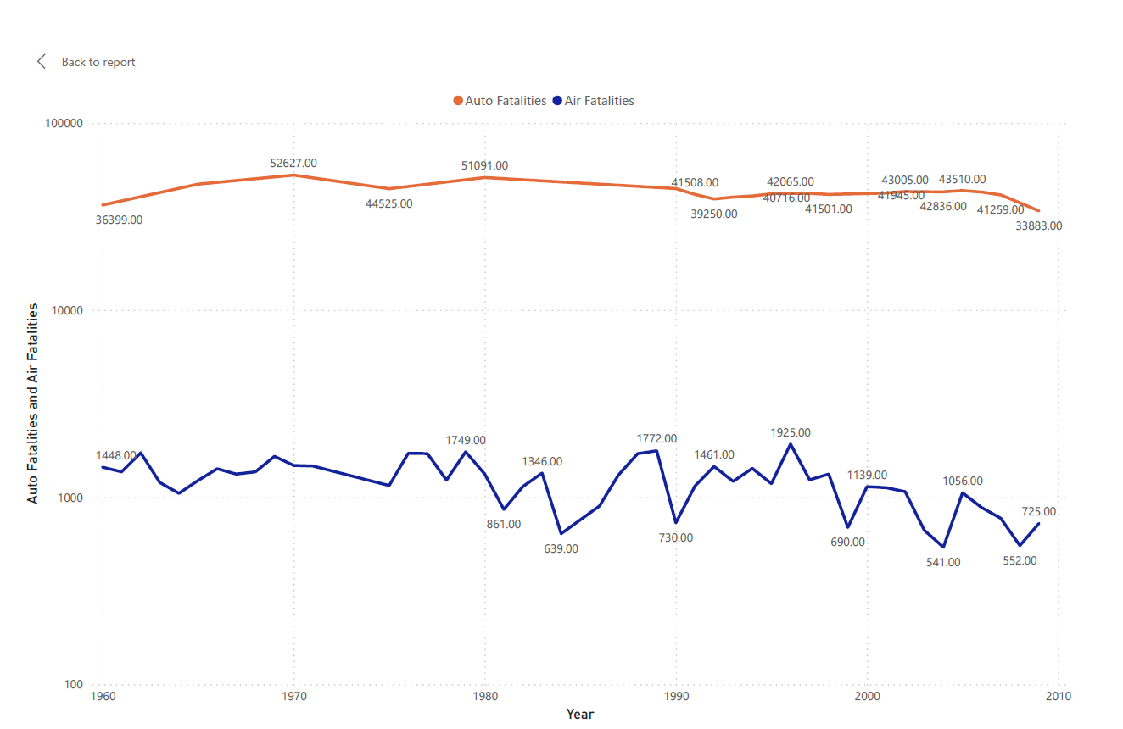
Automobile Fatalities vs Airline Fatalities from 1960 - 2010

Slide 7
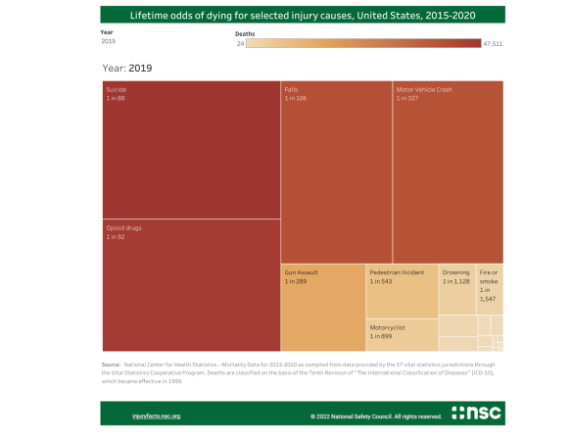
Lifetime odds of dying for selected injury causes in u.s., 2015-2020
In 2019, the lifetime odds of dying due to air and space transport accidents are 1 in 9,446.
The odds of dying by motor vehicle crash are 1 in 107!

Slide 8
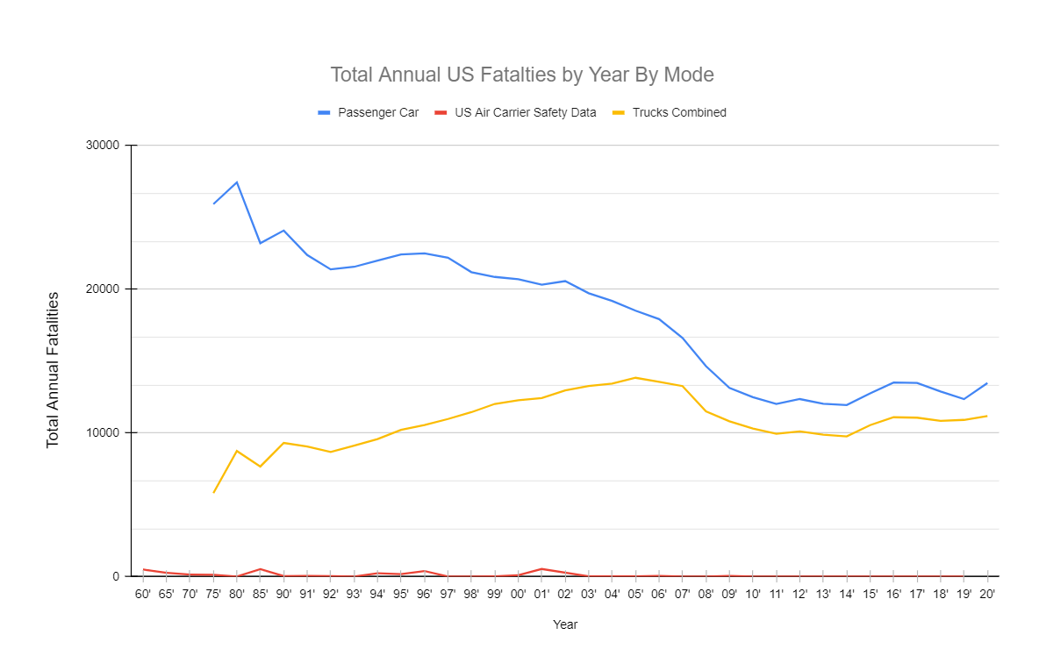
What is the safest mode of transportation in u.s.,then?
Between 2015 & 2020, for passenger cars,
32.28M total crashes
8.8M total injuries
78.4K total fatalities
Between 2015 & 2020, for light and large trucks,
29.8M total crashes
5.7M total injuries
65.6K total fatalities
For the same period, amongst large commercial airlines,
176 total accidents
111 total injuries
5 total fatalities
source for the data and graph: flyfright.com/statistics

Slide 9
conclusion
MEDIA REPORTS ARE PATENTLY INACCURATE AND FALSE
THE ODDS OF AIRPLANE CRASH AND DEATH ARE EXTREMELY SMALL
AIR FLIGHT IS STILL THE SAFEST MEANS OF TRANSPORTATION AMONGST OTHER MODES
THUS, FLY WITH AIR USA TO TRAVEL SAFER AND FURTHER TOGETHER!

